Slide 1
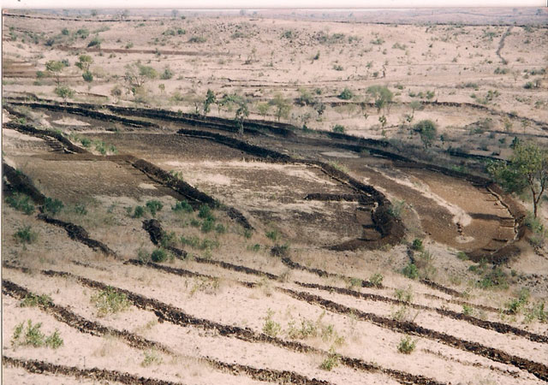
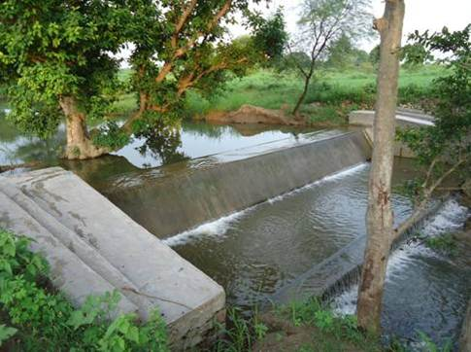
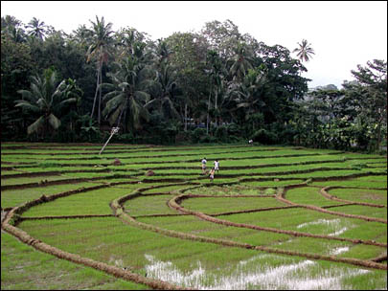
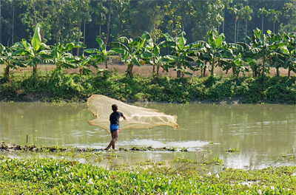
Welcome to
officials of Agril and allied sectors of RKVY
Training Program on
GEO-TAGGING OF RKVY ASSETS
USING GEO-PORTAL TECHNOLOGIES
PV Krishna Rao
B Shyamsunder
RKVY Program
NRSC-ISRO, Hyderabad
Tel: 040-23884539
040-23884569
Mail: rkvy.nrsc@gmail.com
National Remote Sensing Centre / ISRO, Balanagar, Hyderabad

Slide 2
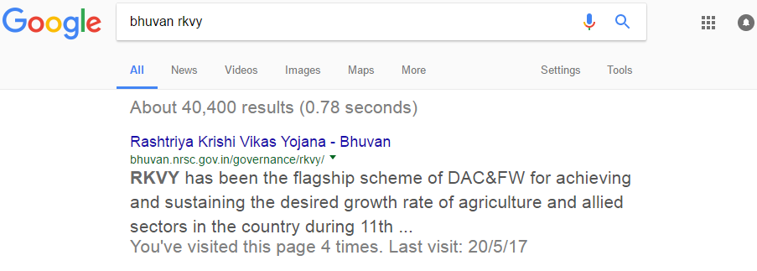
Open Google.co.in
Type: Bhuvan RKVY
Click Here

Slide 3
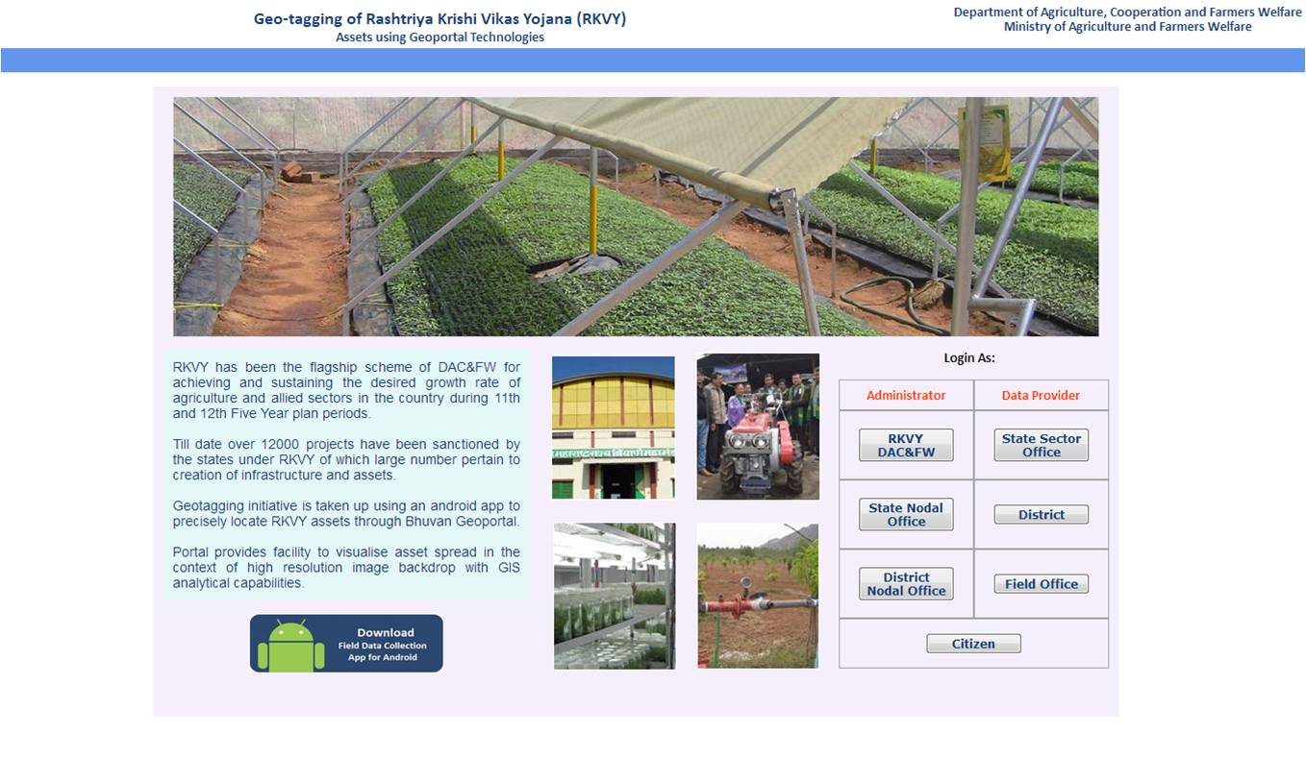
http://bhuvan.nrsc.gov.in/governance/rkvy
All field officers need to Down Load Bhuvan RKVY app to Mobile phone and upload assets

Slide 4
All Users to Register on Bhuvan Portal
(State Sector/ District Sector/ Field Offices)
http://bhuvan.nrsc.gov.in/governance/rkvy/register
To download App, visualise and moderate assets on Bhuvan Portal
(District Sector/ State Sector)
http://bhuvan.nrsc.gov.in/governance/rkvy

Slide 5
Instructions before opening Bhuvan RKVY app
Check ON for GPS in mobile
2.Camera aperture should not be
more than 2 MP
3.Ensure space of 1 GB in mobile
4.Battery in full

Slide 6
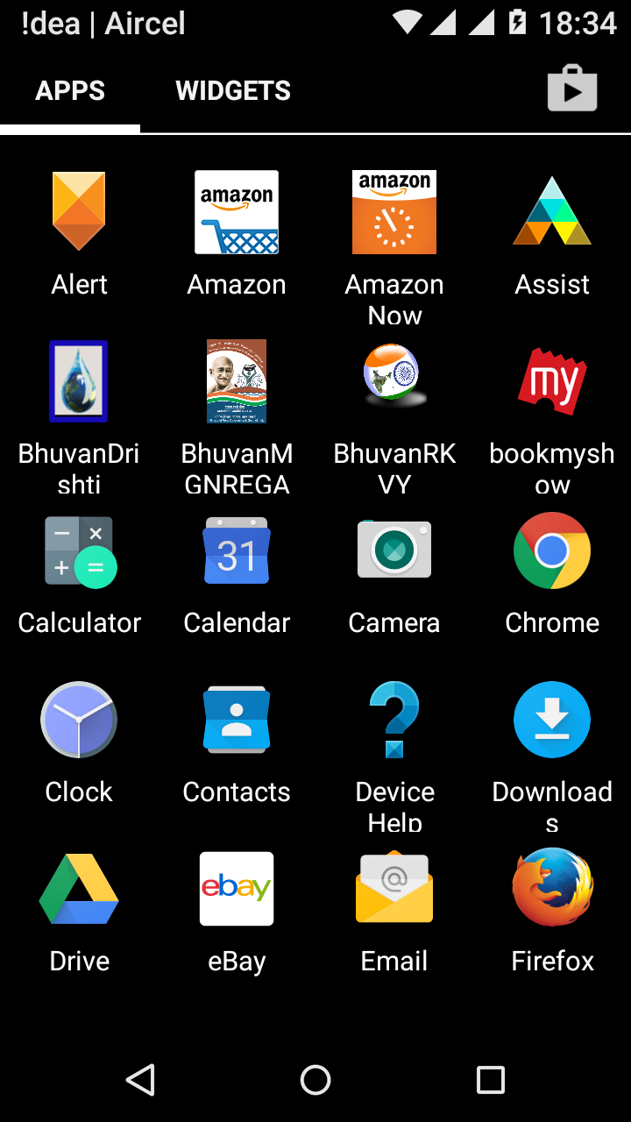

Slide 7
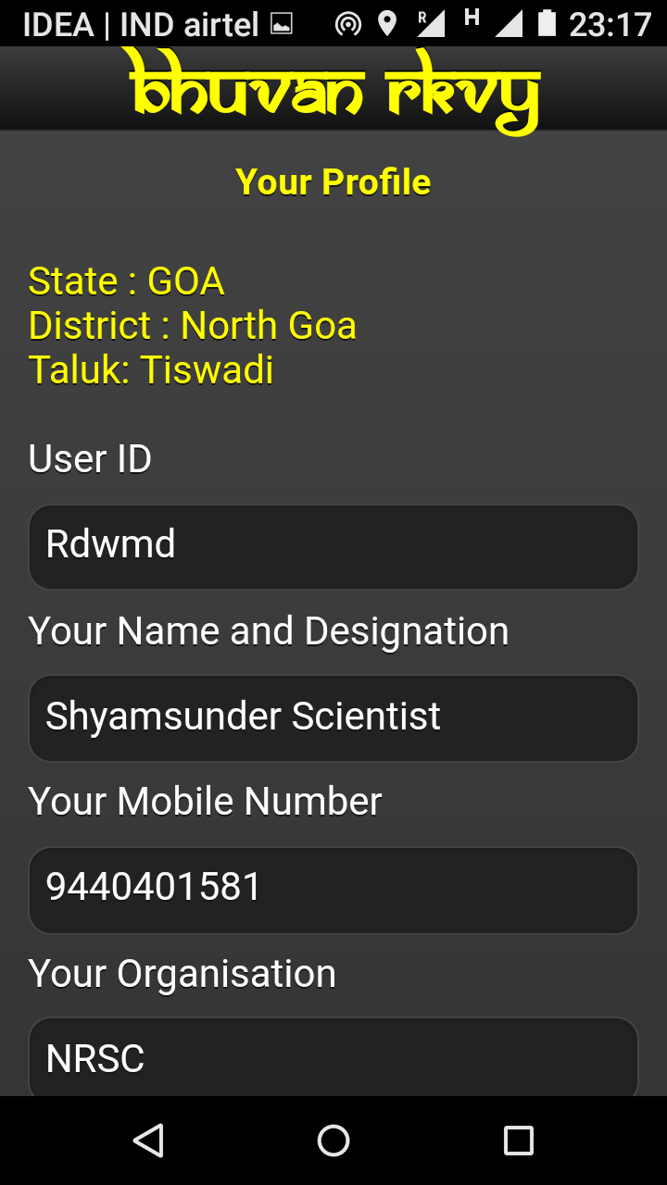
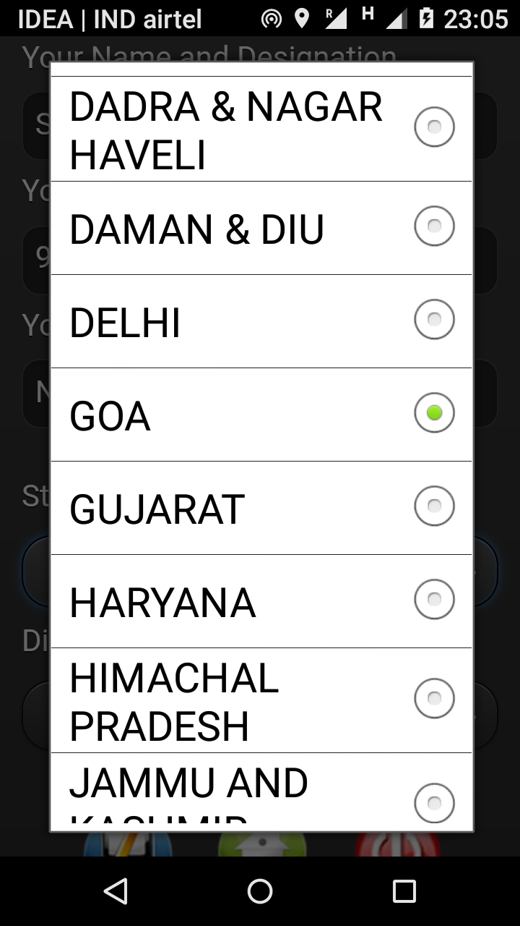
State District
mnp_XXXX
Department

Slide 8
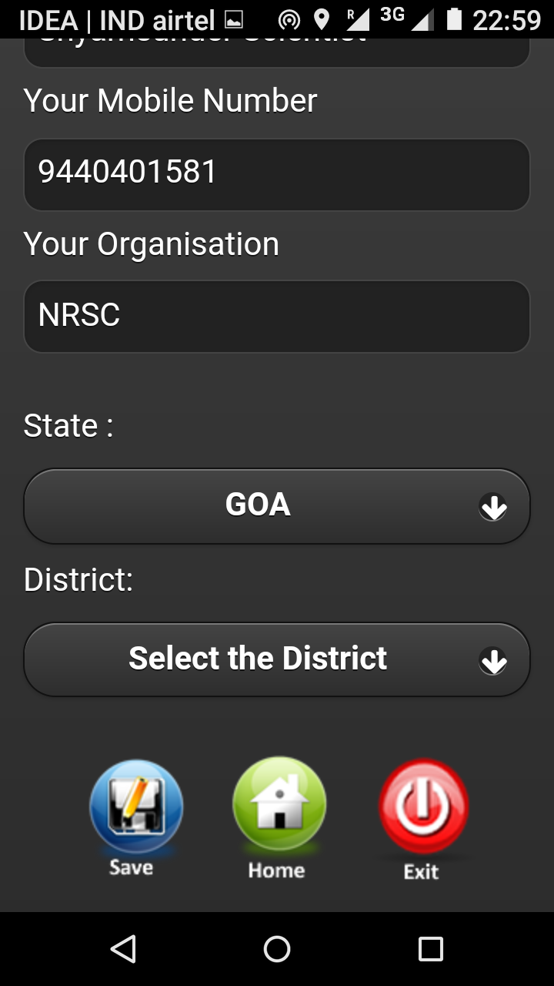
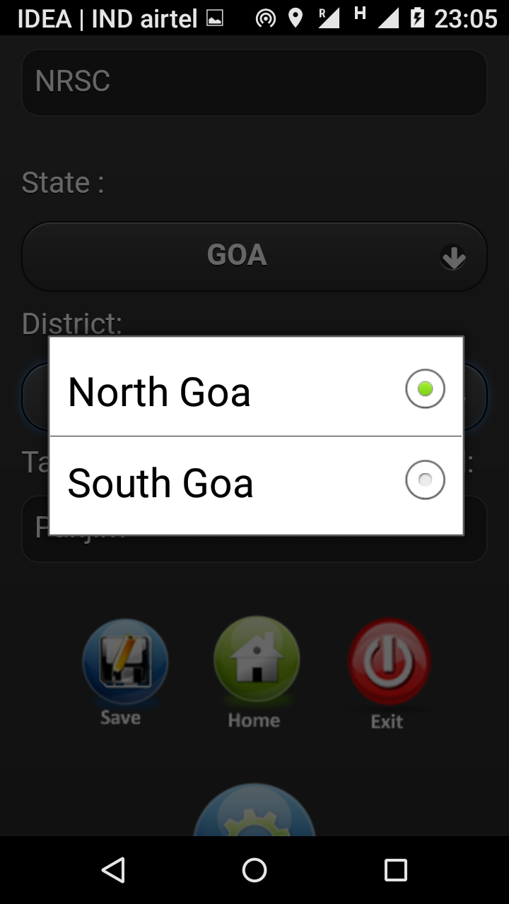

Slide 9
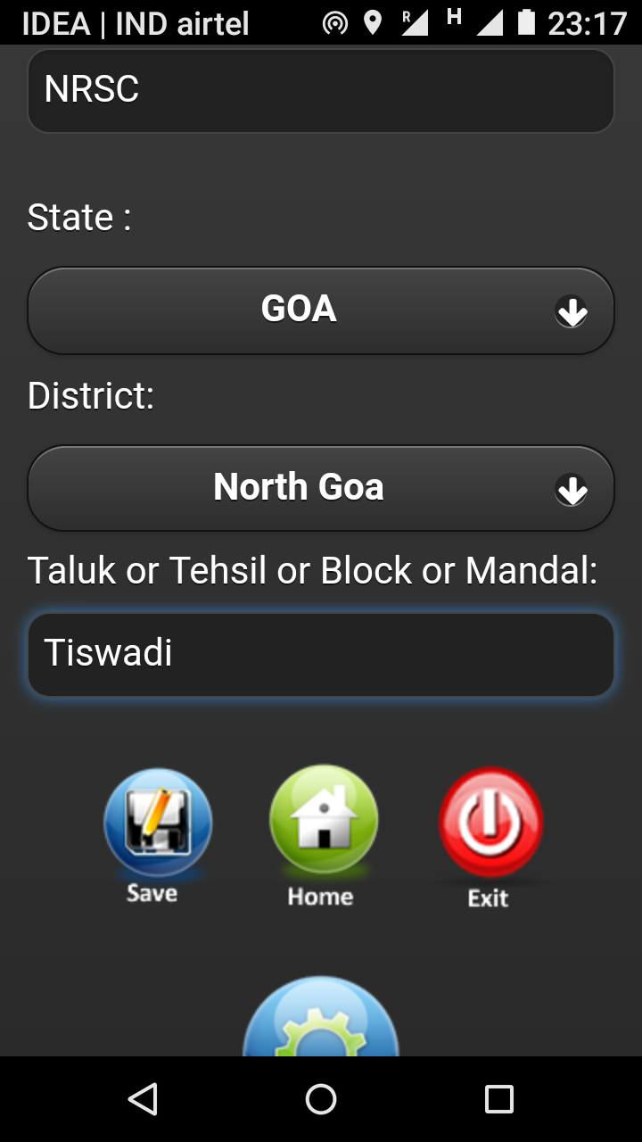
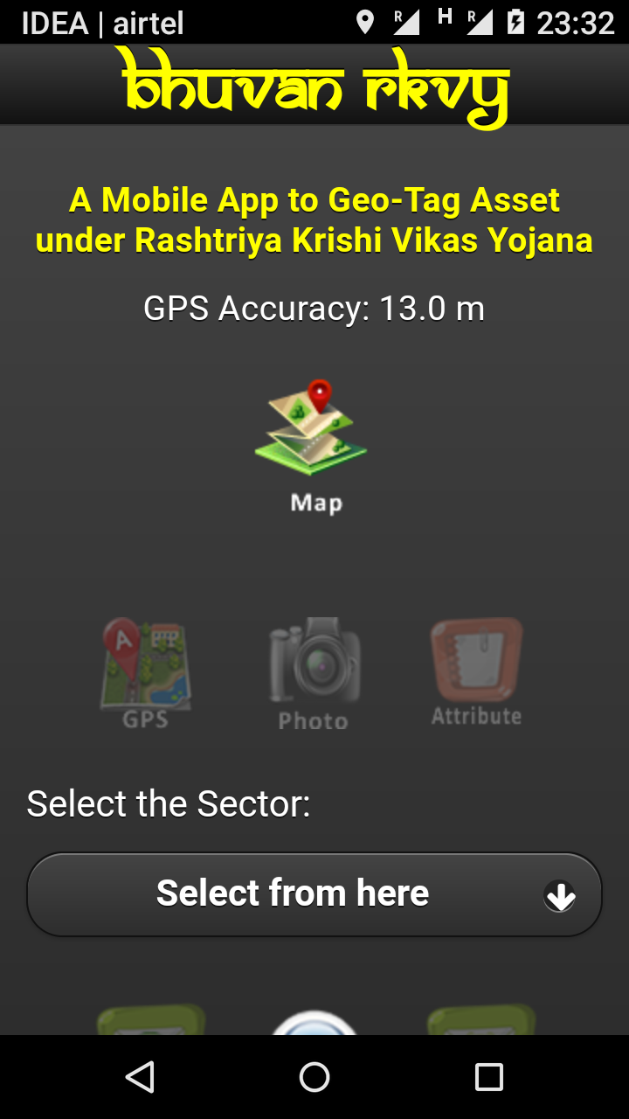

Slide 10
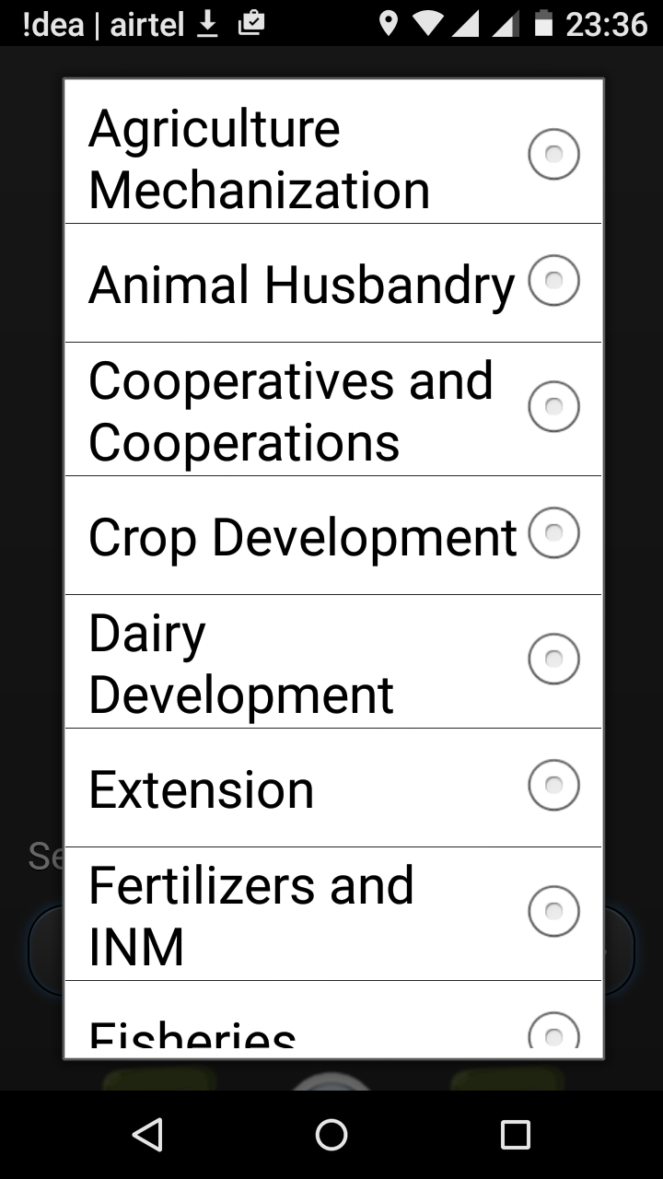

Slide 11
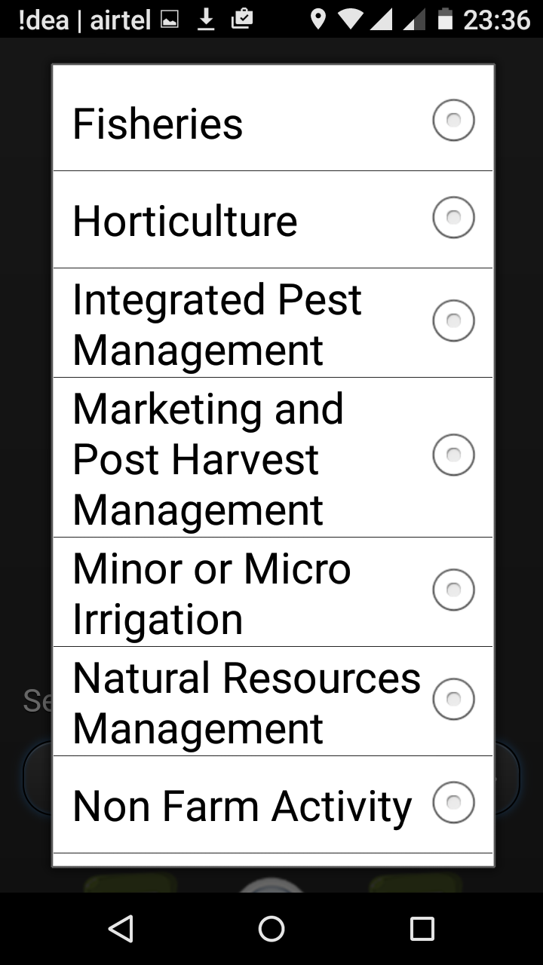
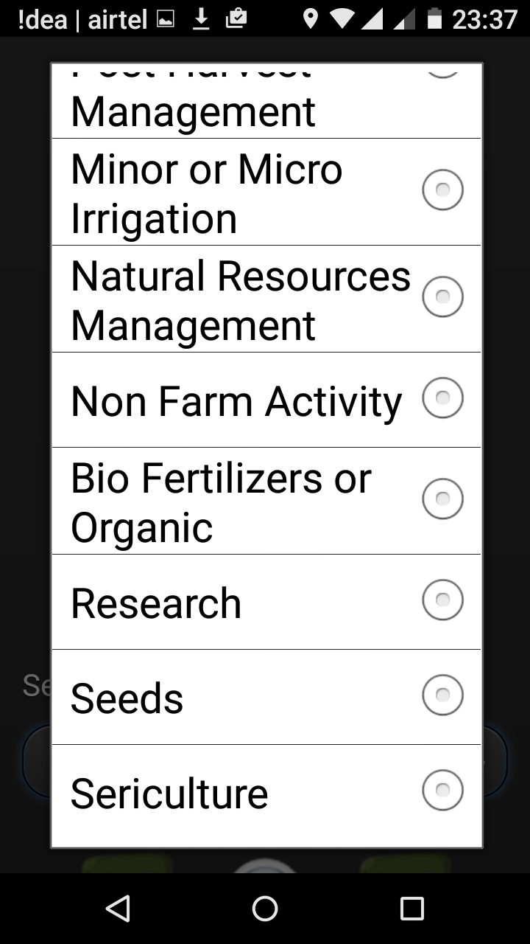

Slide 12
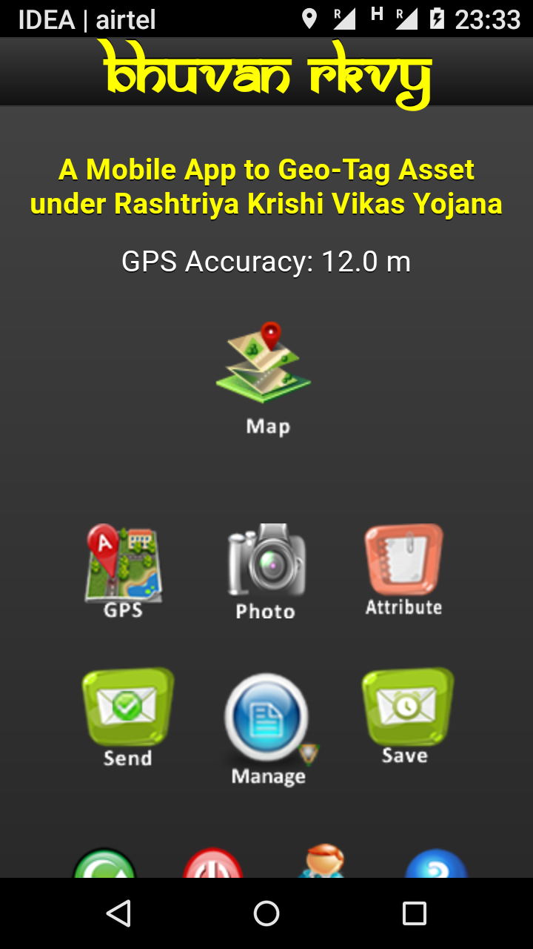
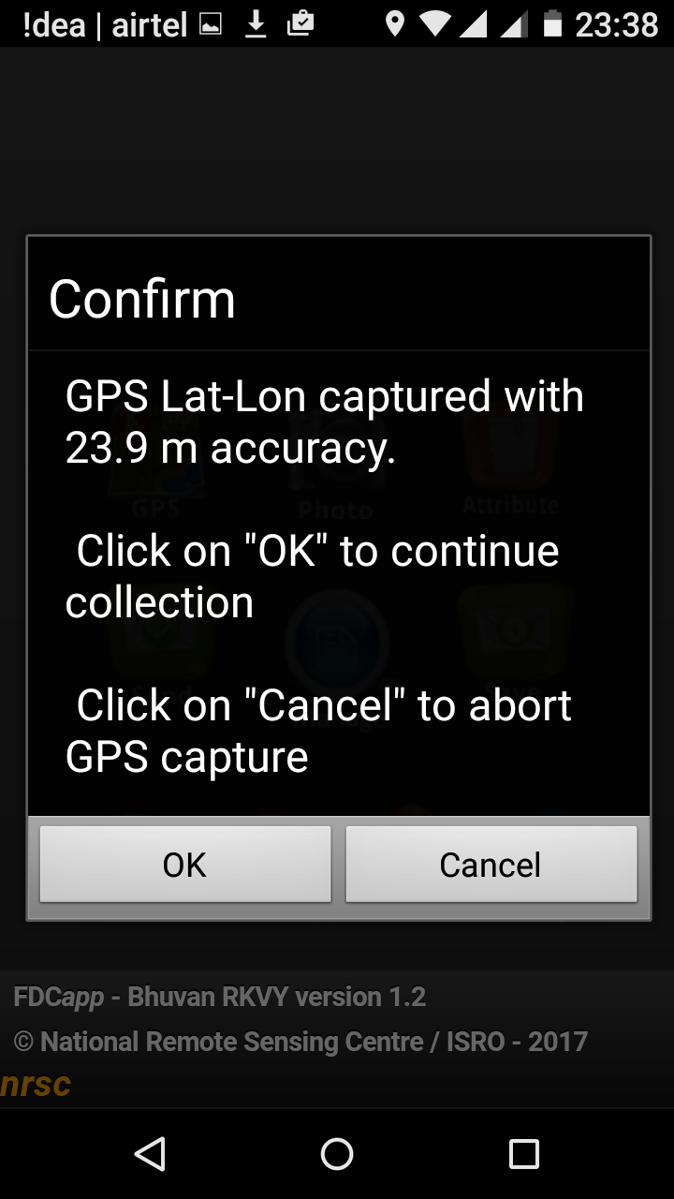

Slide 13
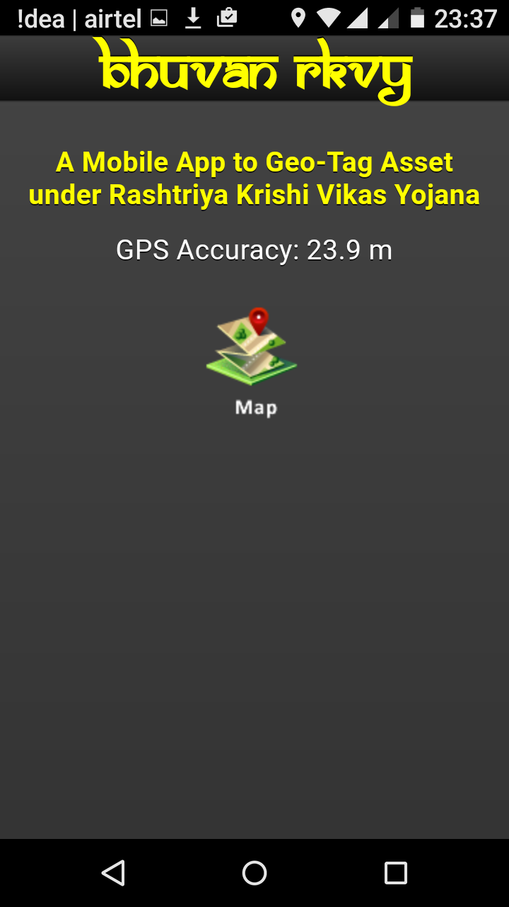
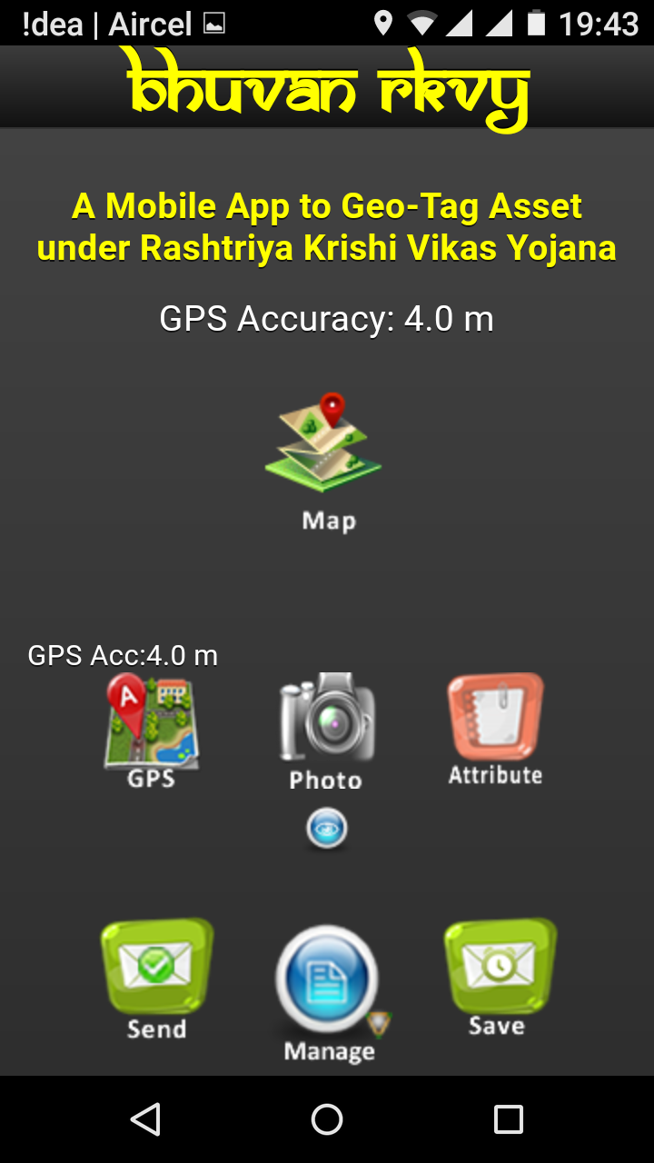
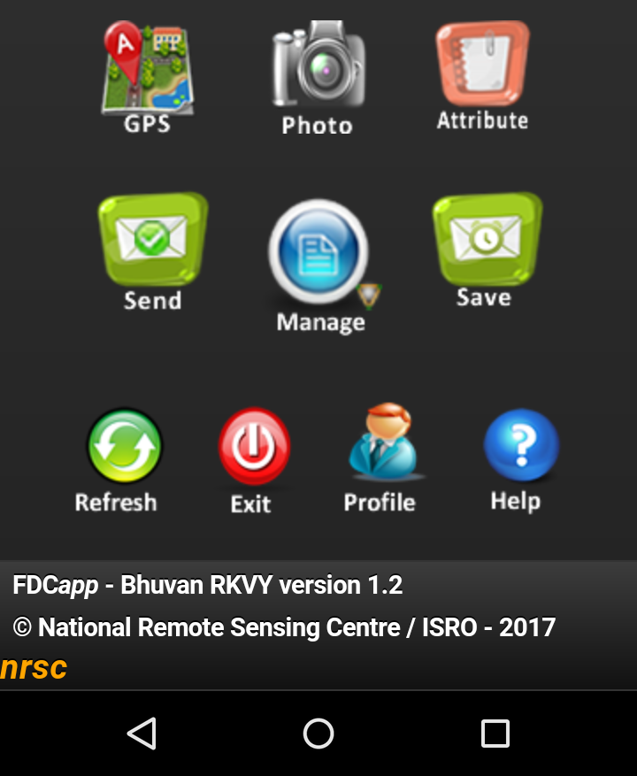

Slide 14
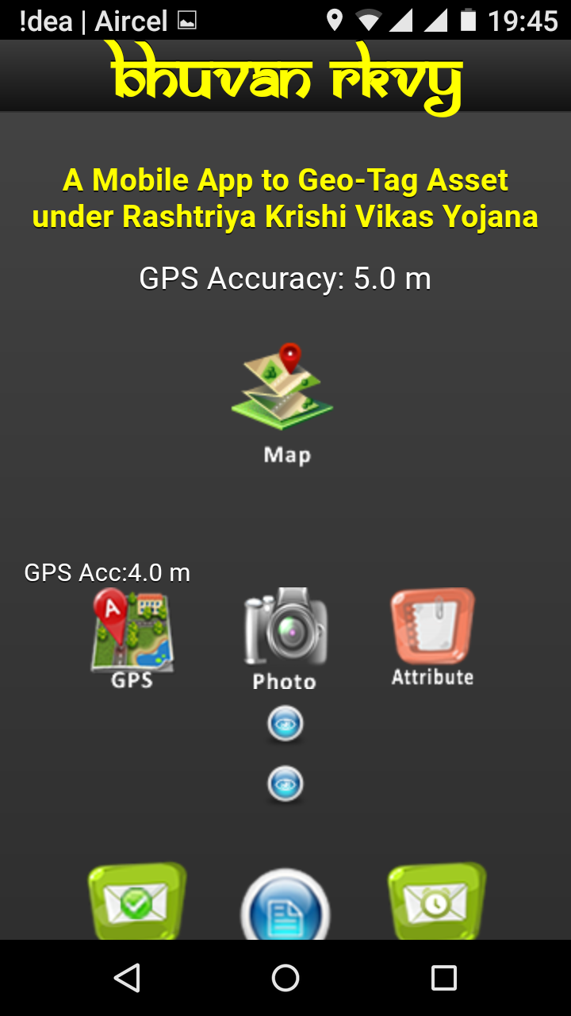
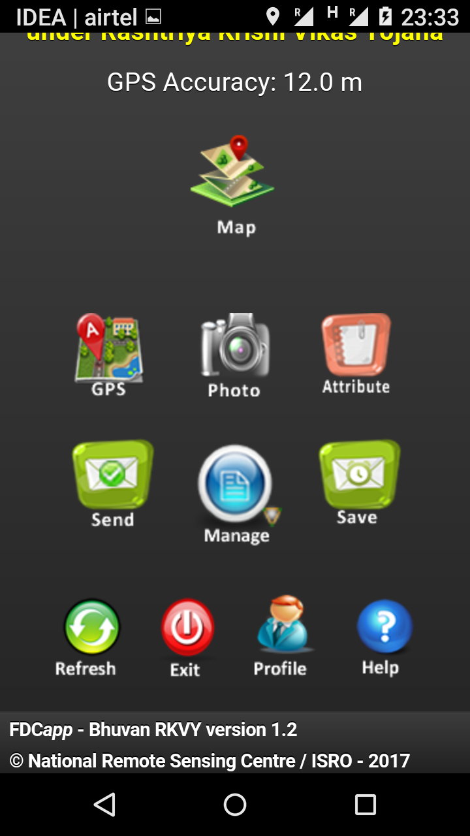

Slide 15
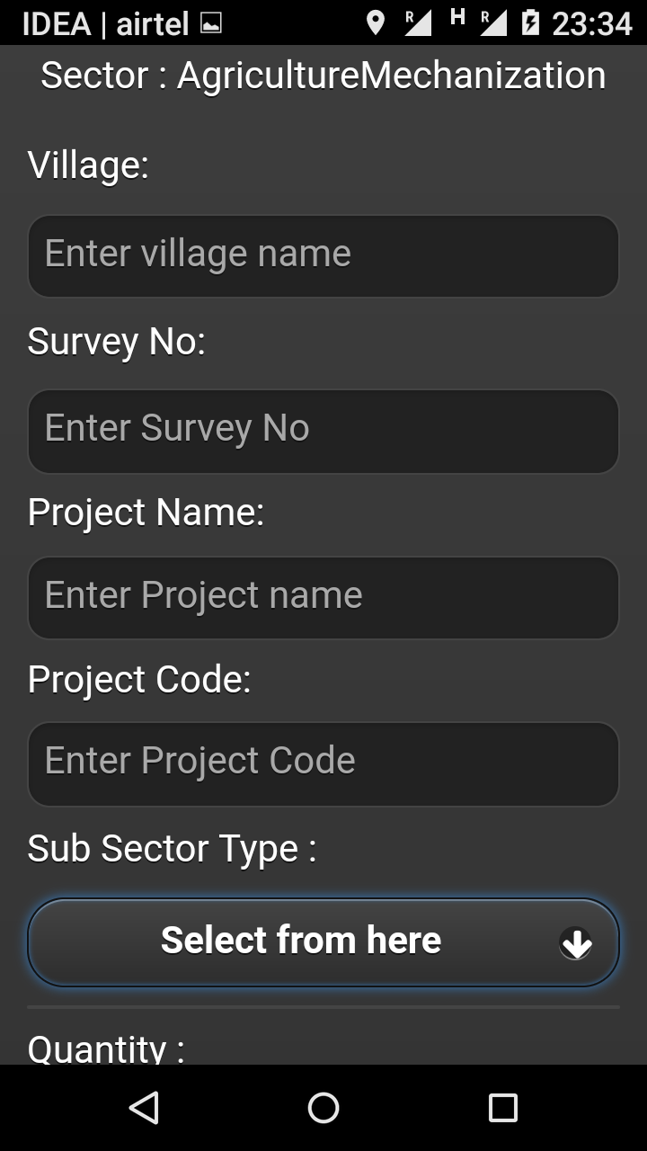
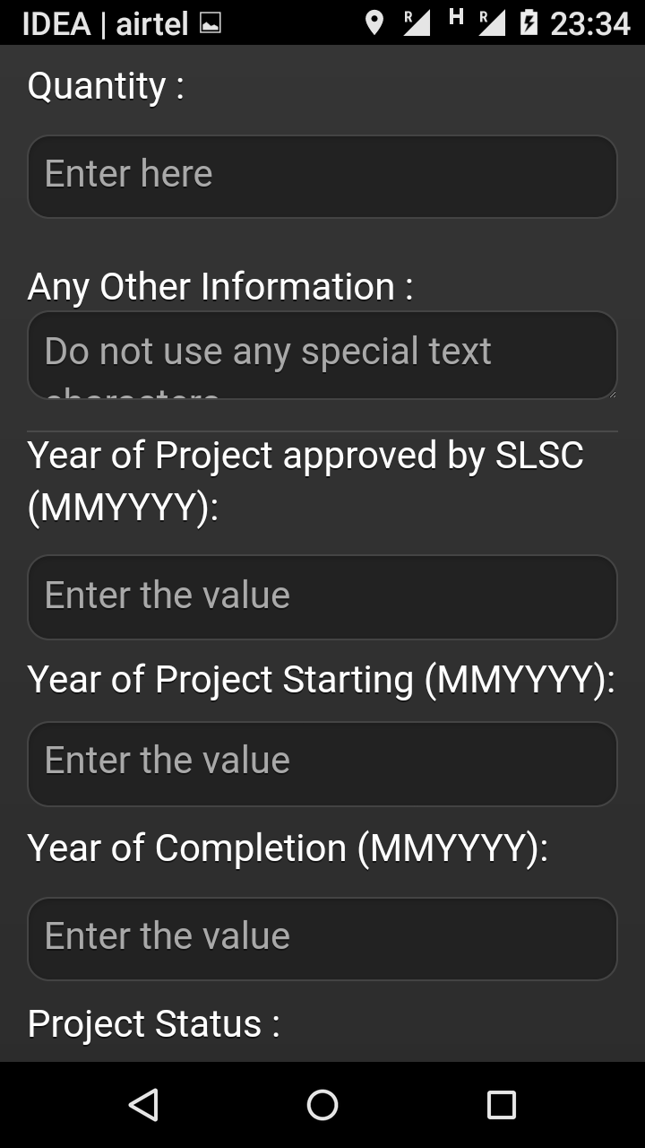

Slide 16
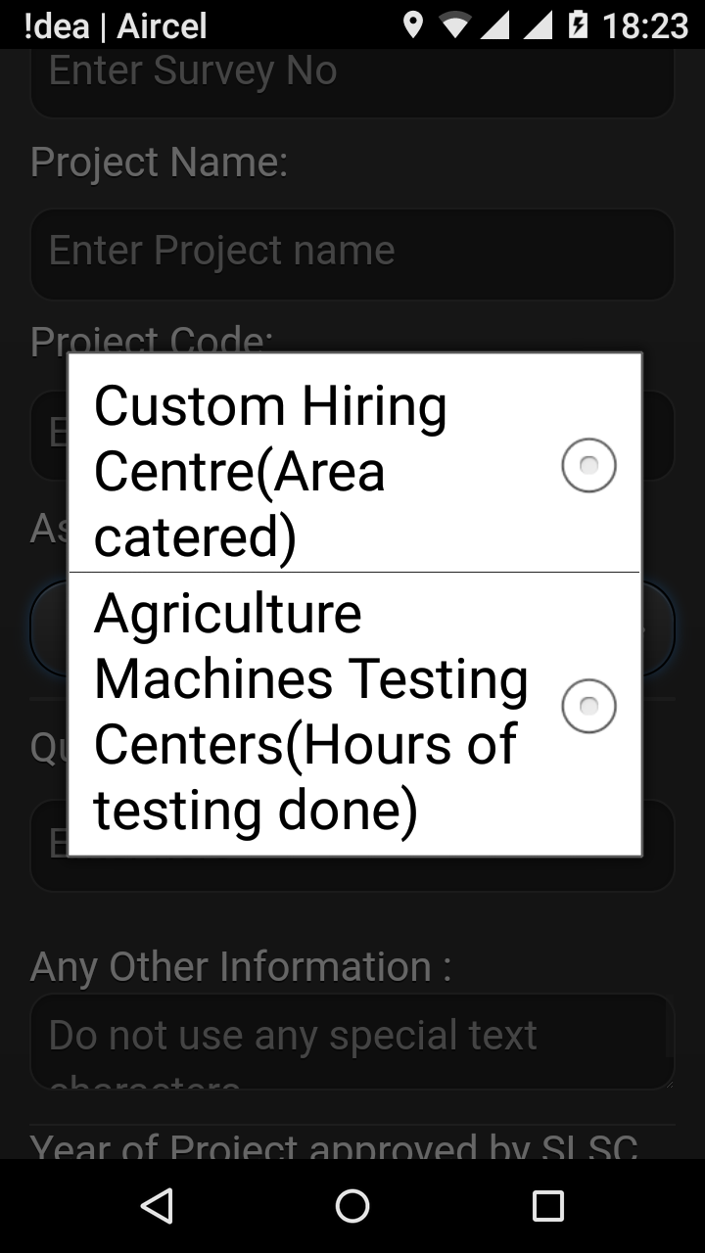

Slide 17
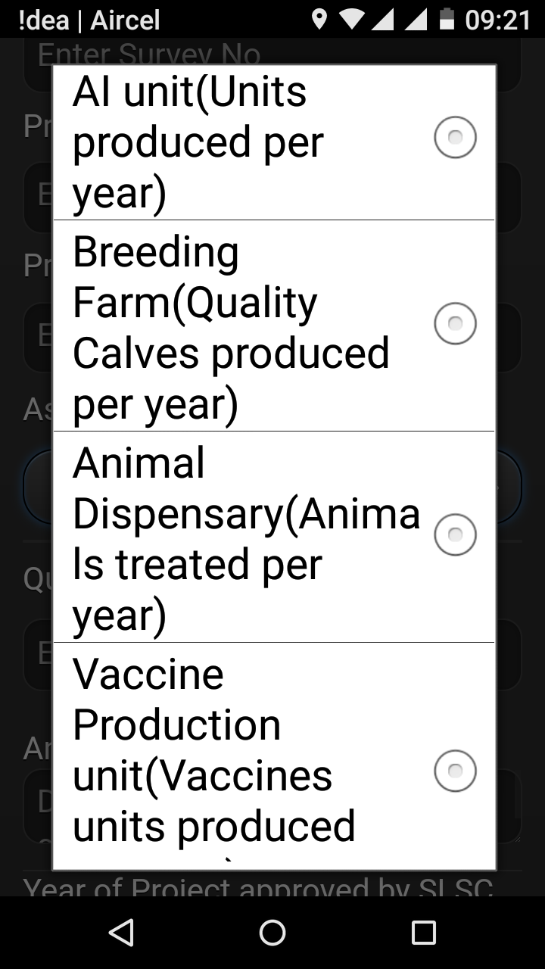

Slide 18
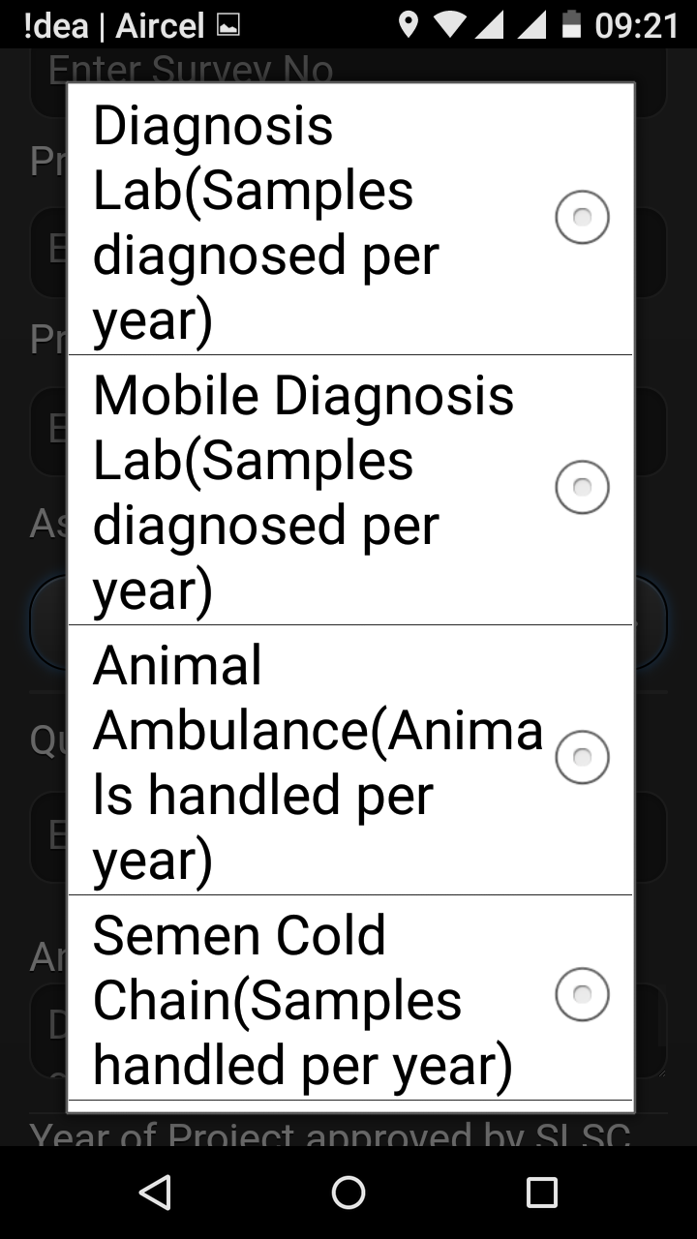
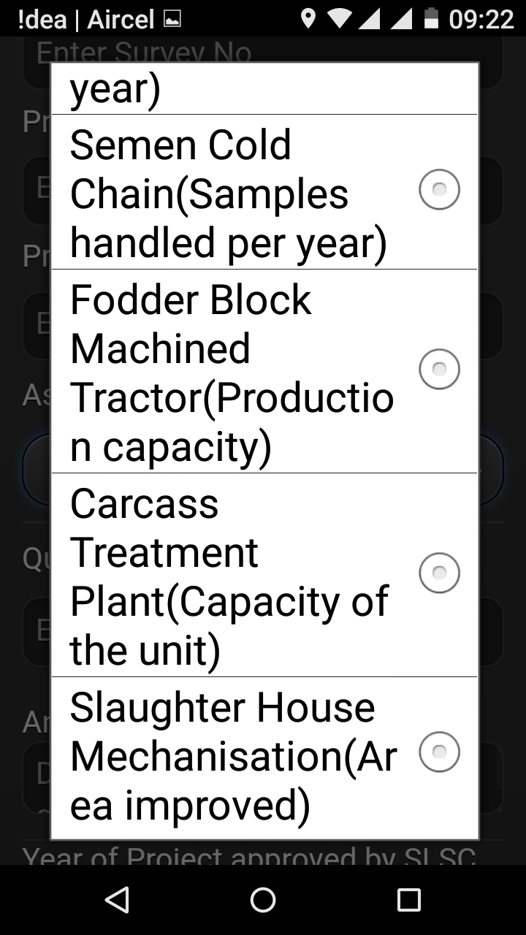
ANIMAL HUSBANDRY

Slide 19
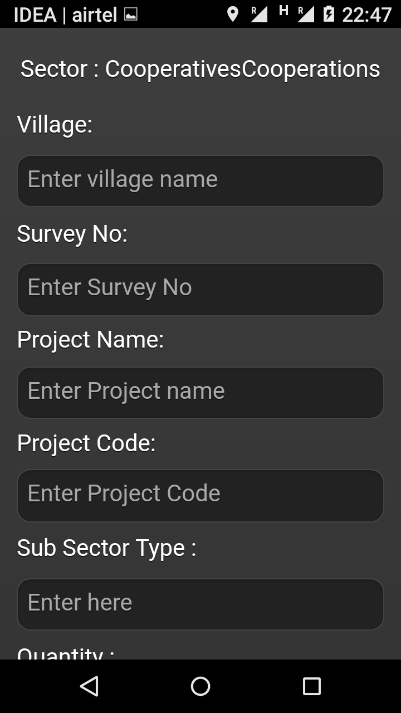

Slide 20
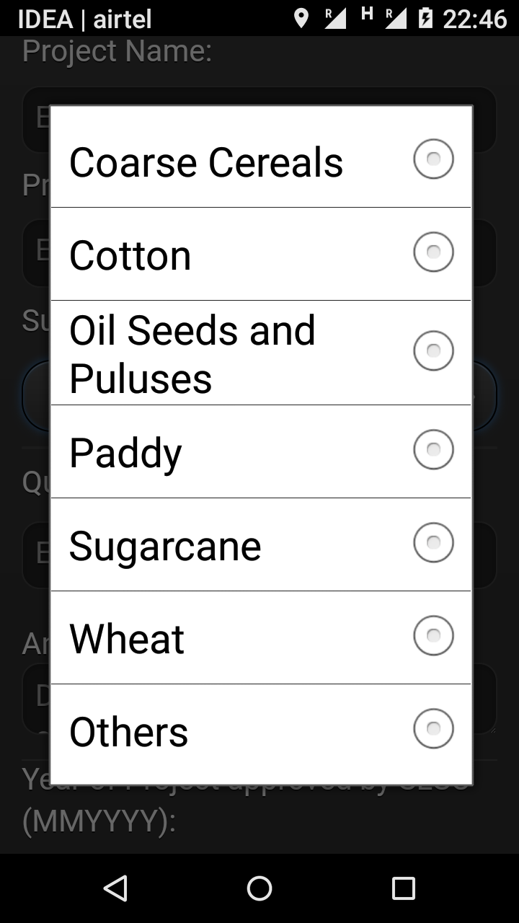

Slide 21
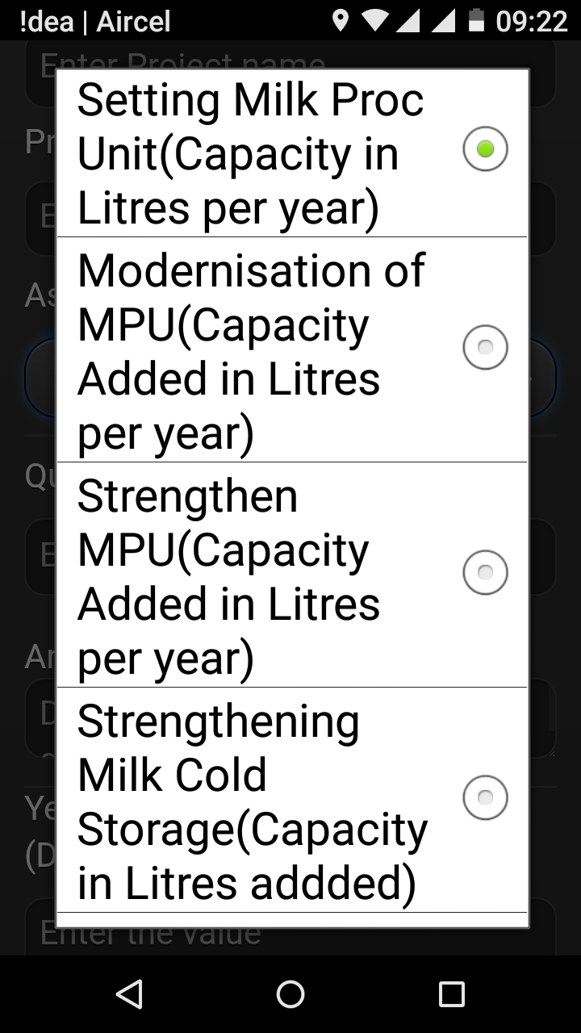

Slide 22
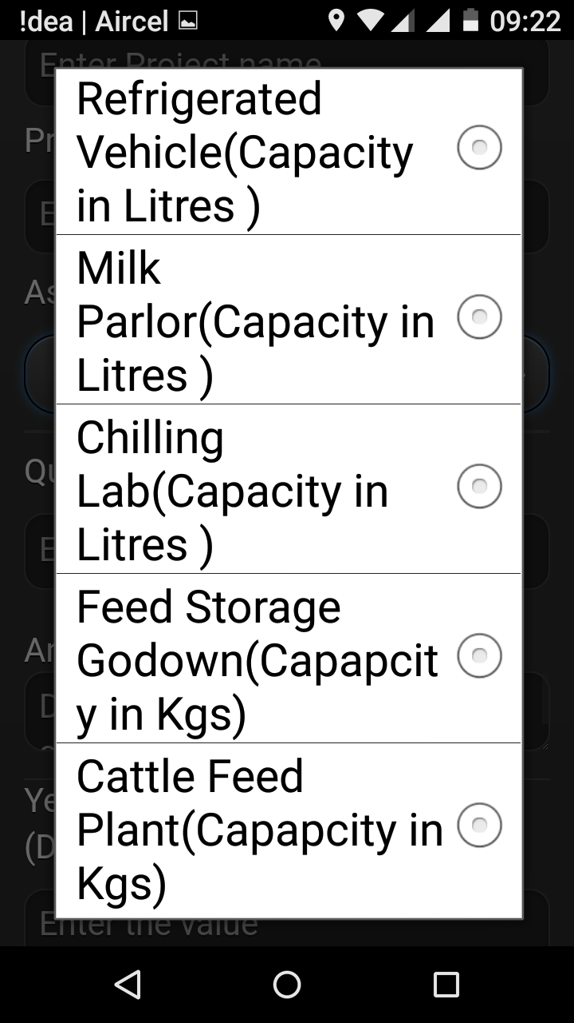
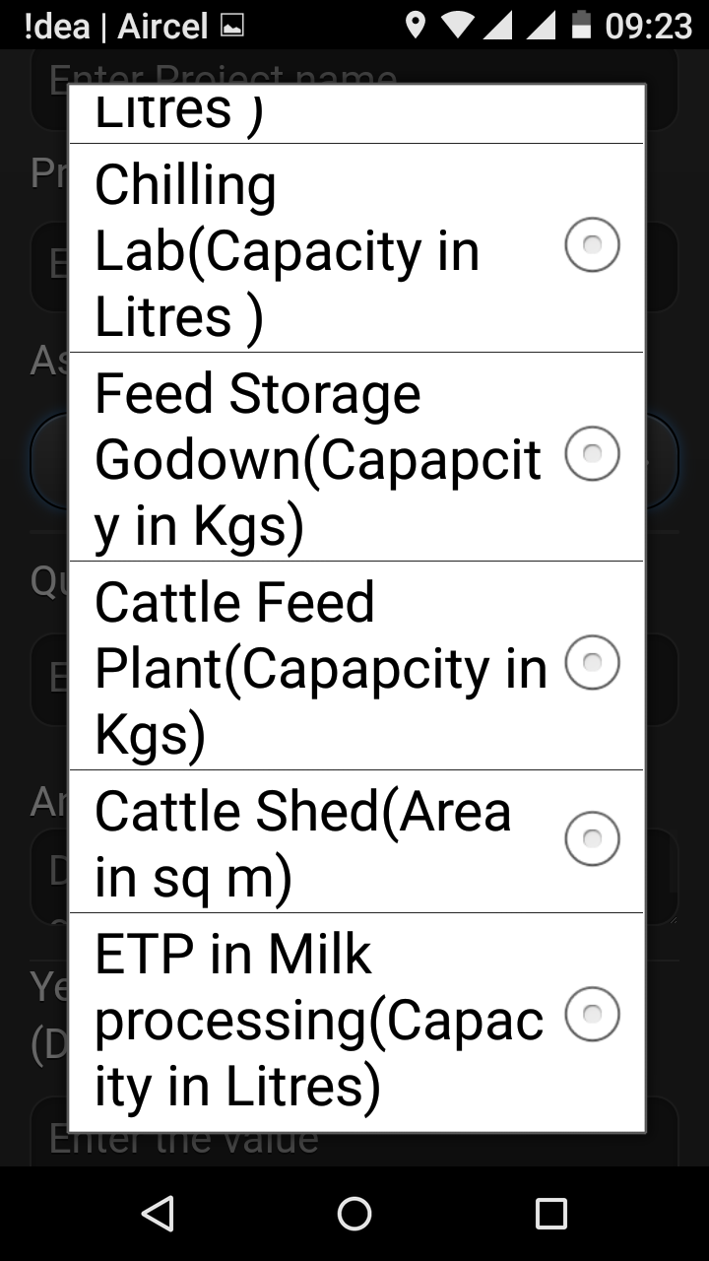
DAIRY DEVELOPMENT

Slide 23
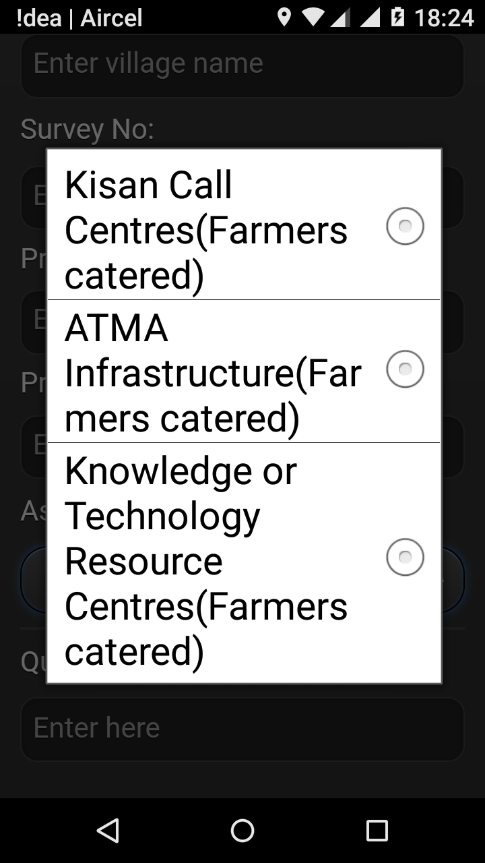

Slide 24
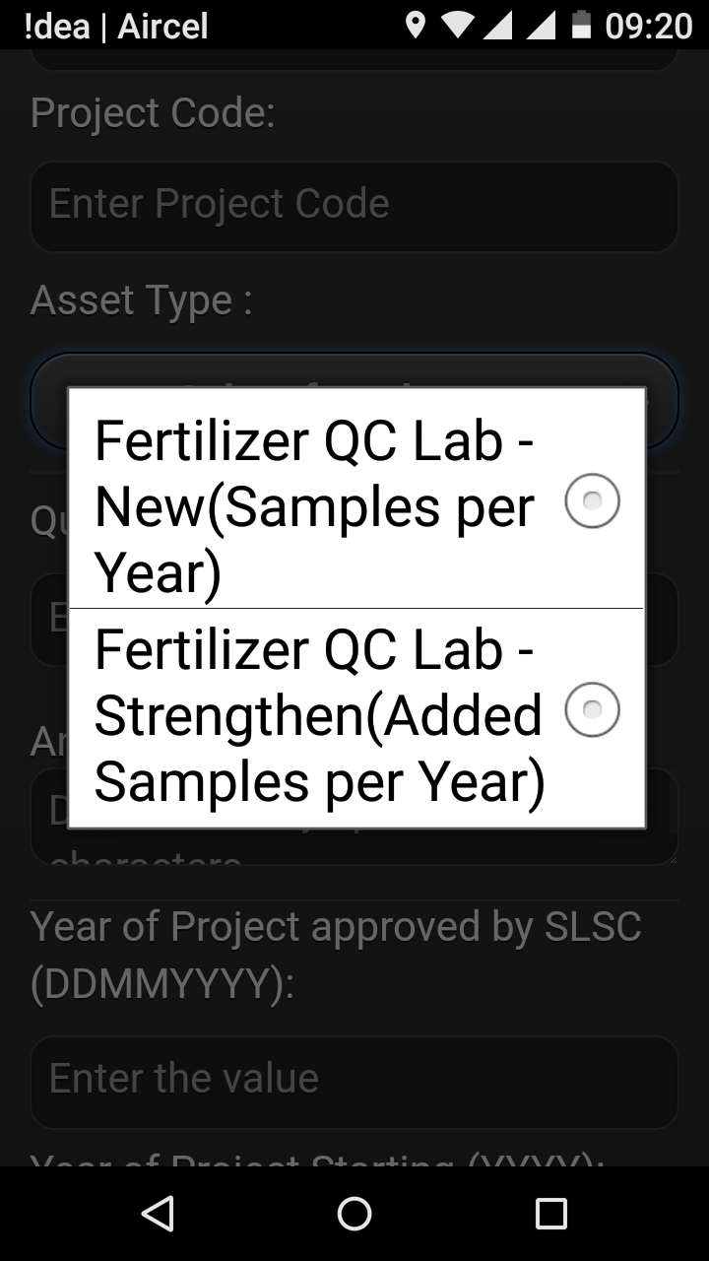

Slide 25
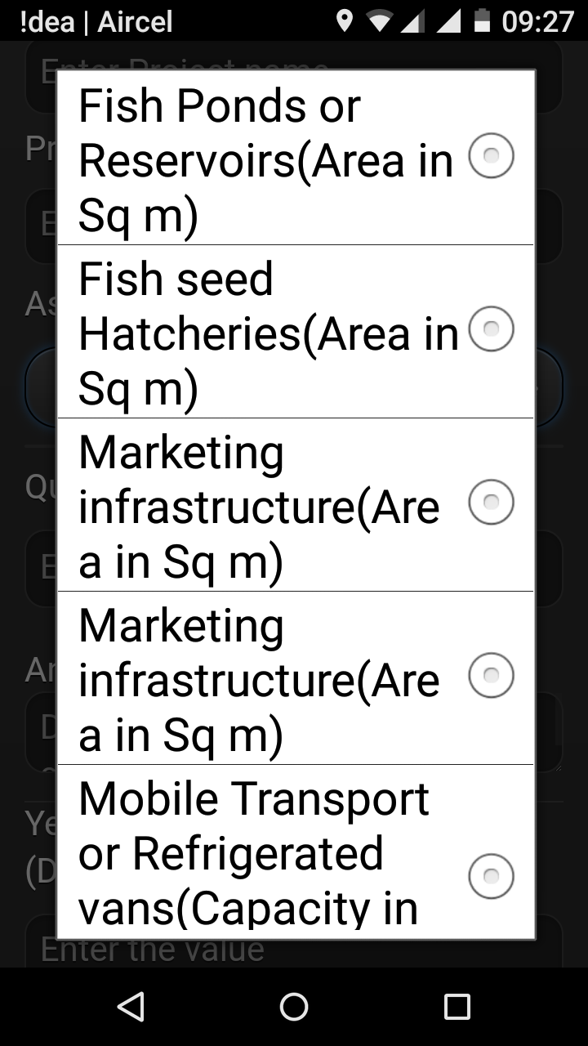
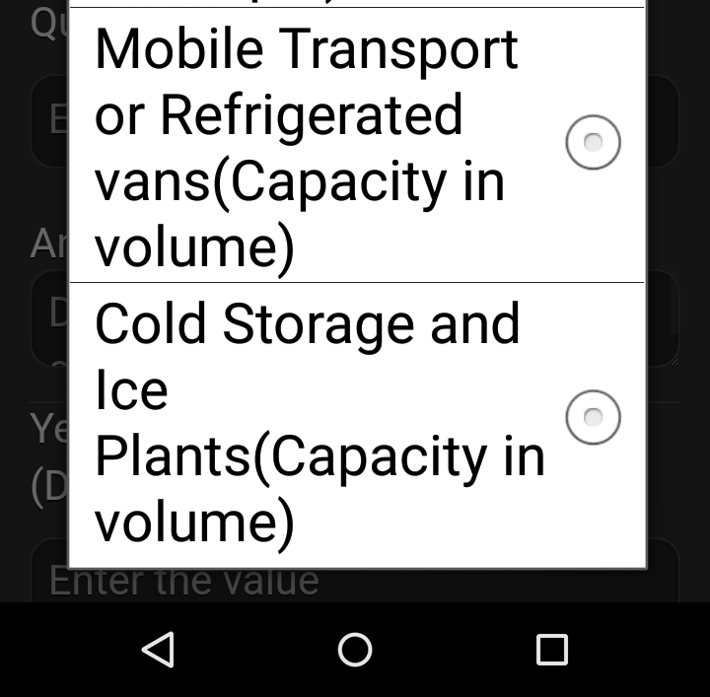
FISHERIES

Slide 26
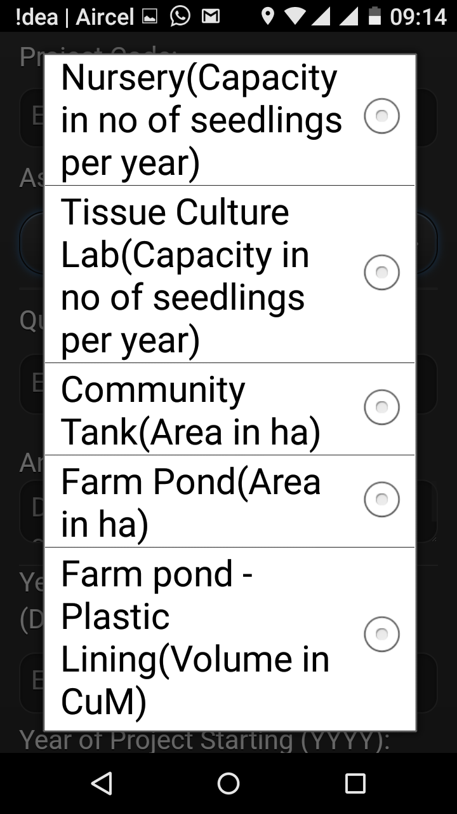
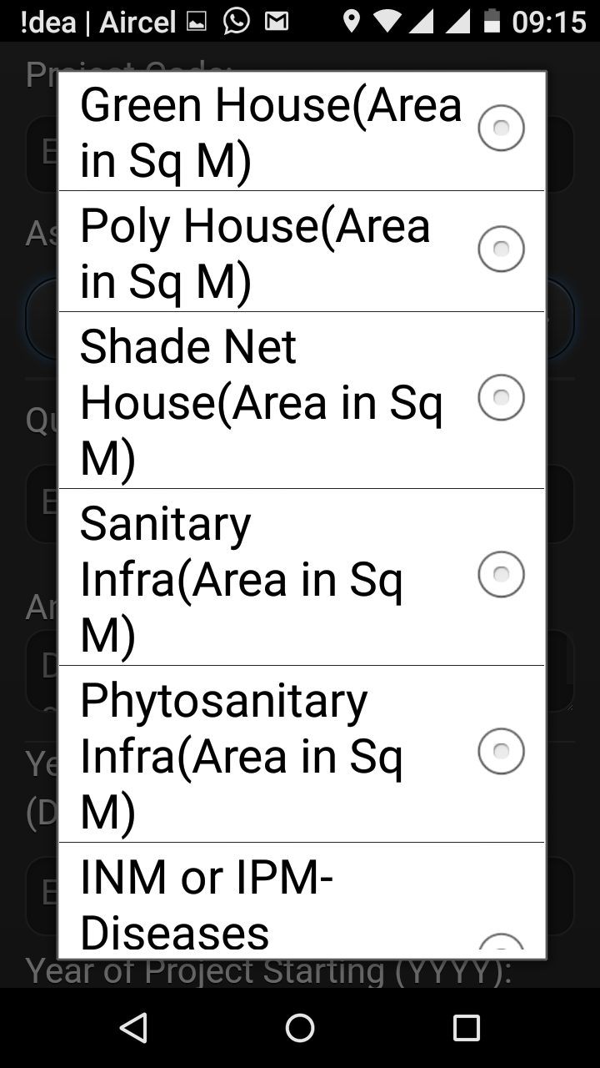
HORTICULTURE

Slide 27
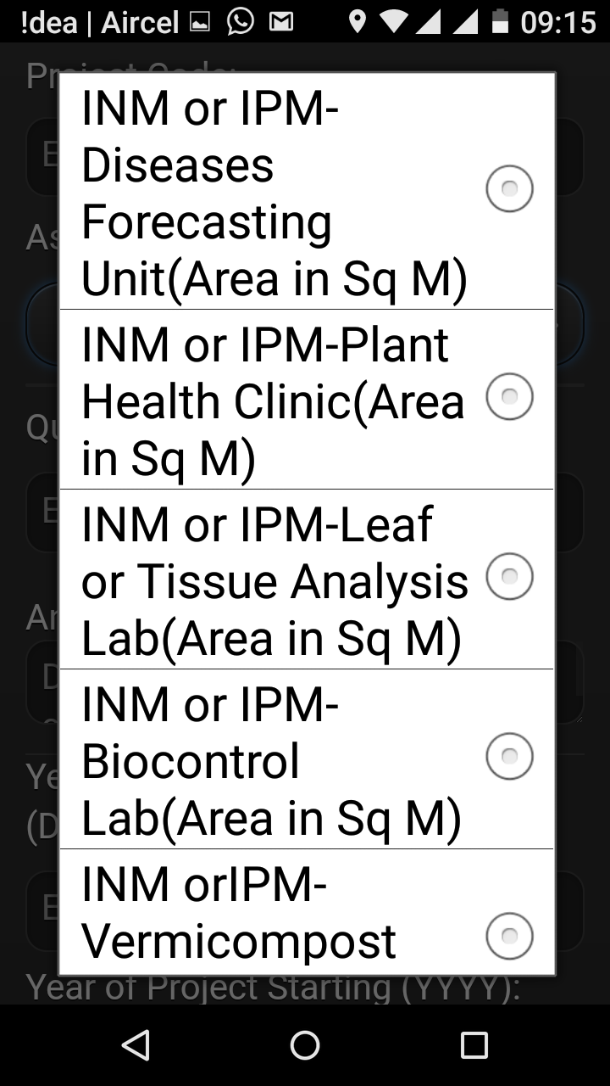
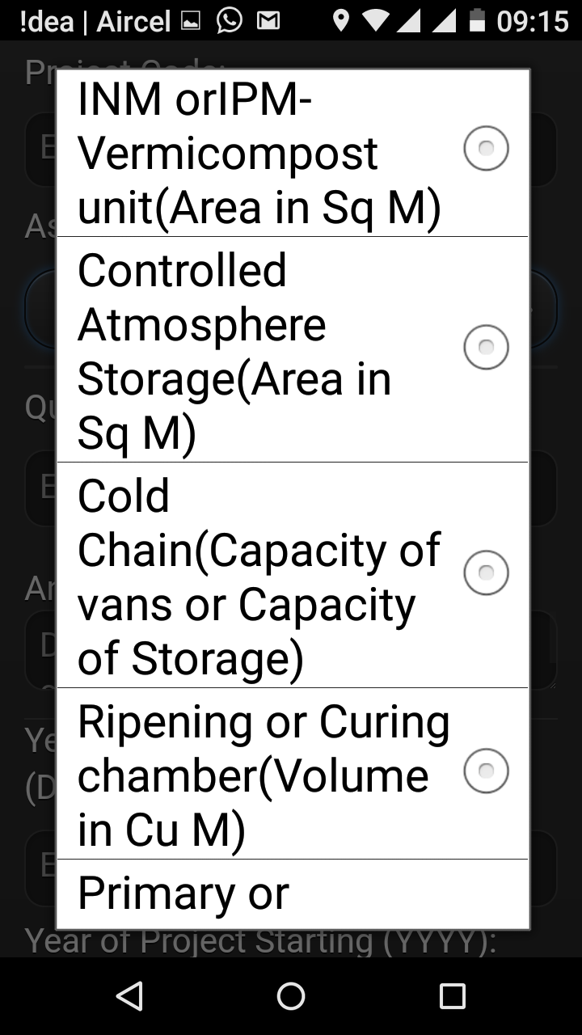
HORTICULTURE

Slide 28
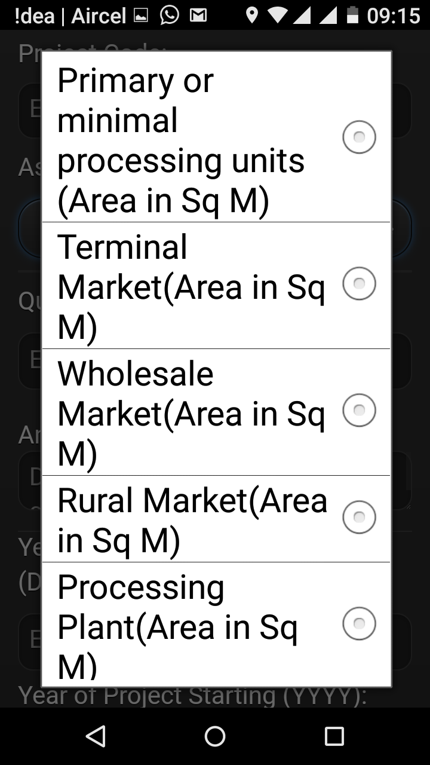
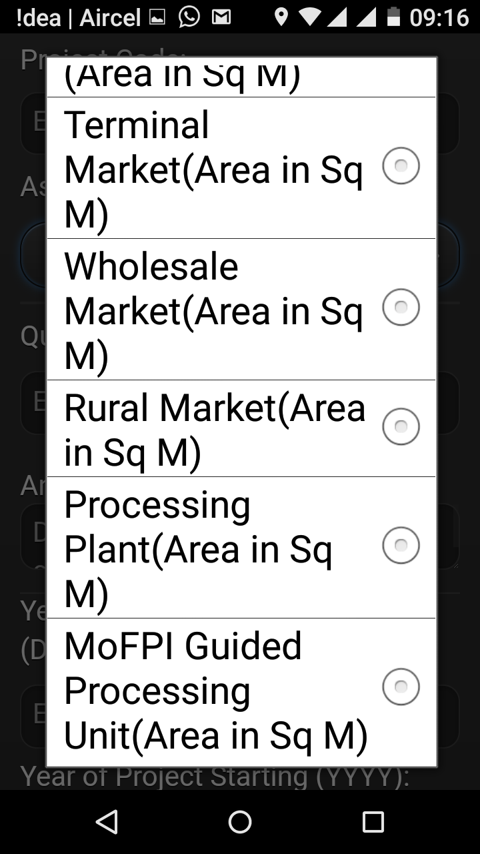
HORTICULTURE

Slide 29
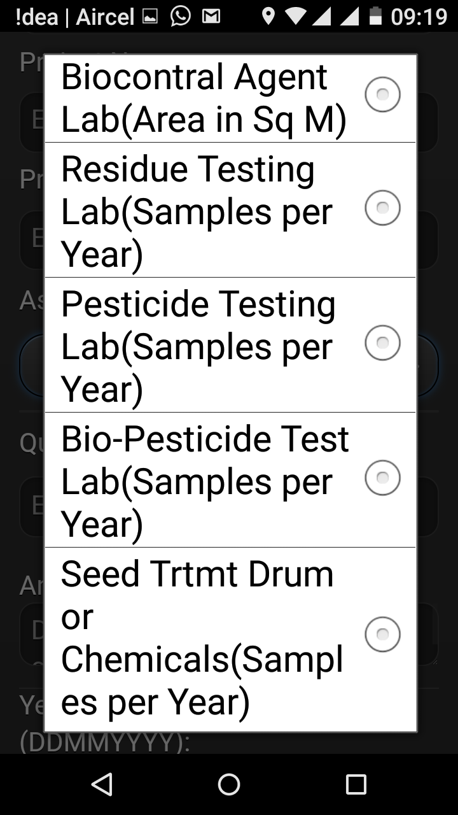

Slide 30
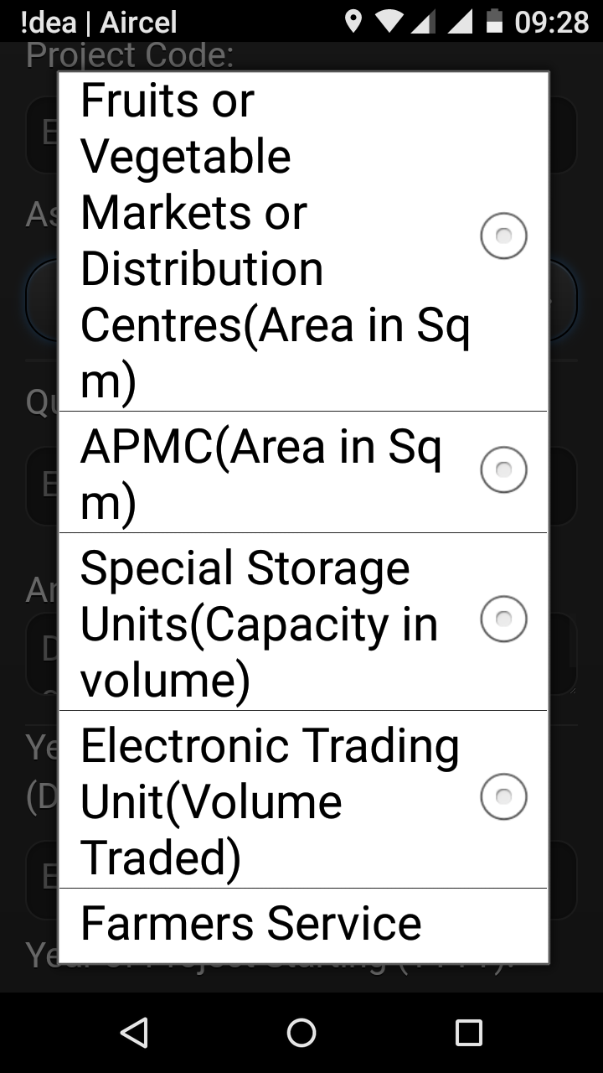

Slide 31
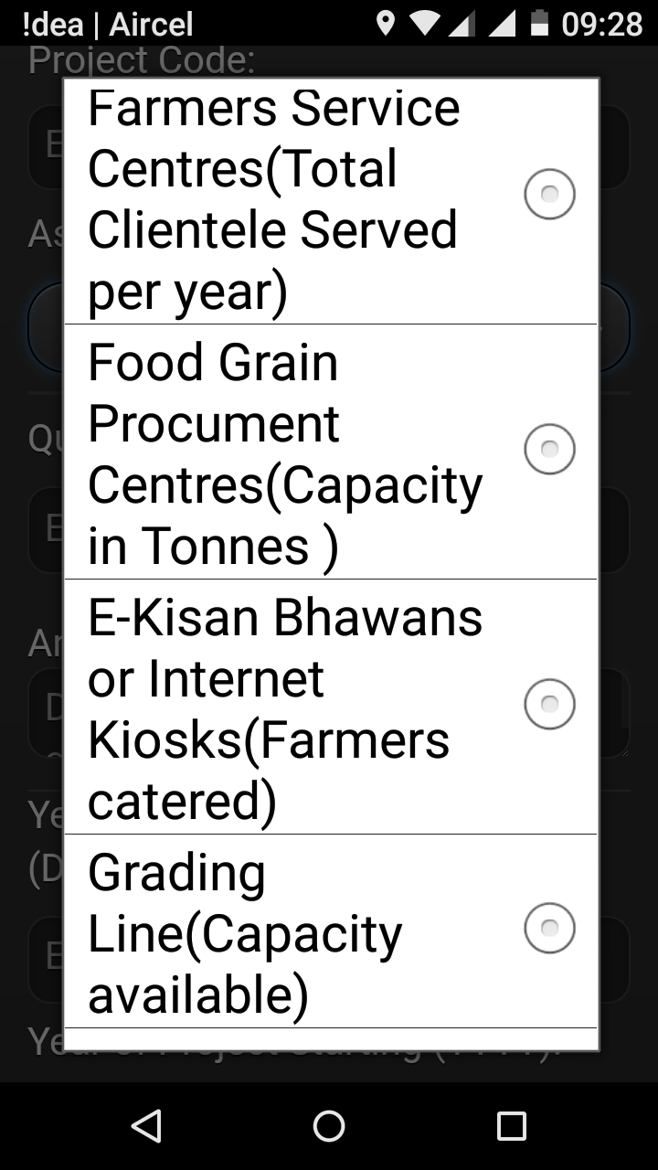
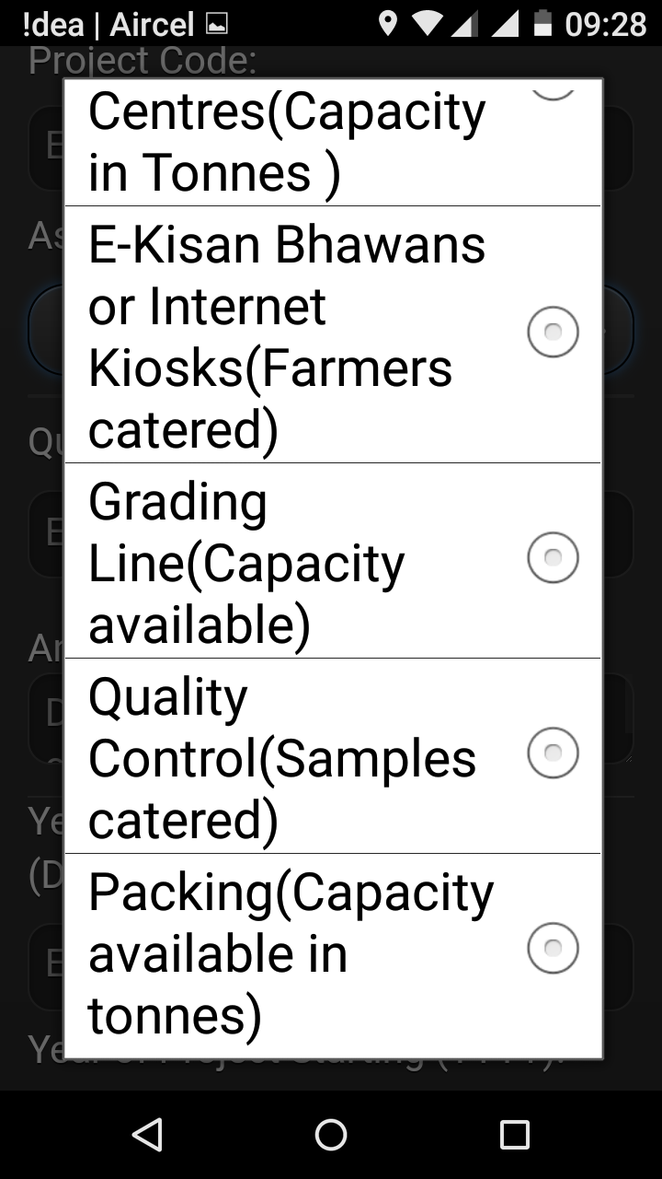
MARKETING & POST HARVEST

Slide 32
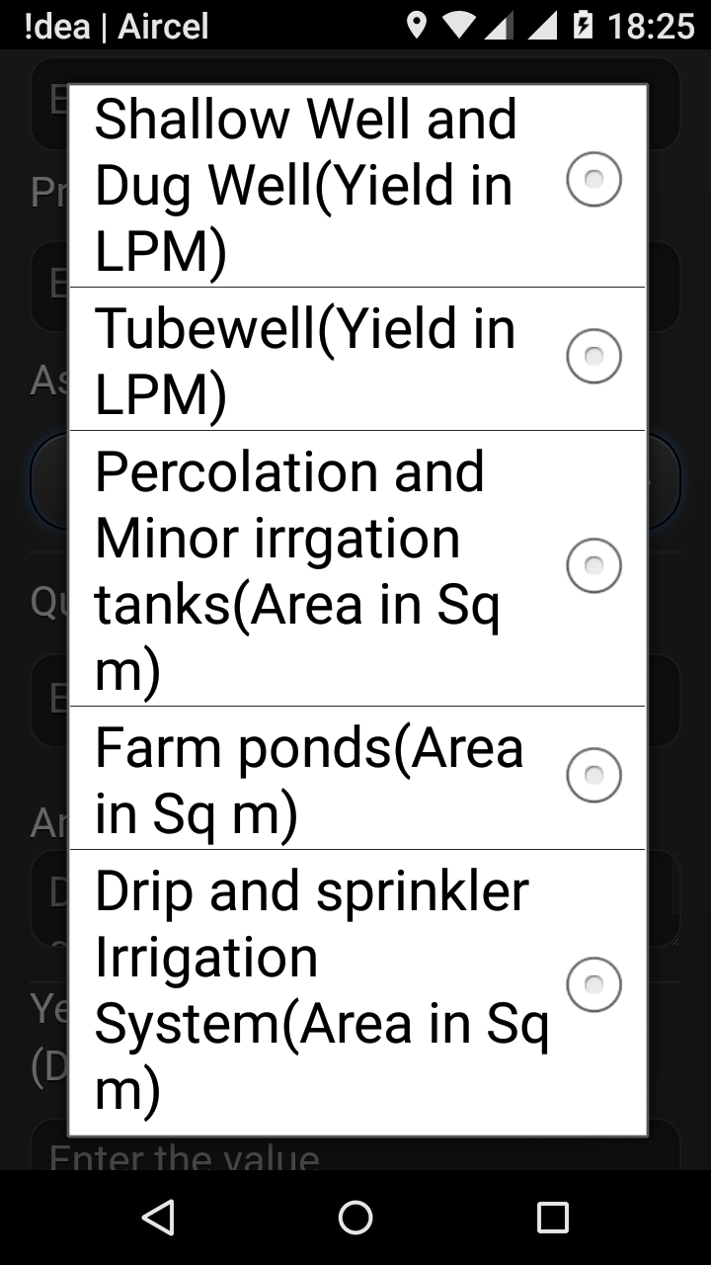
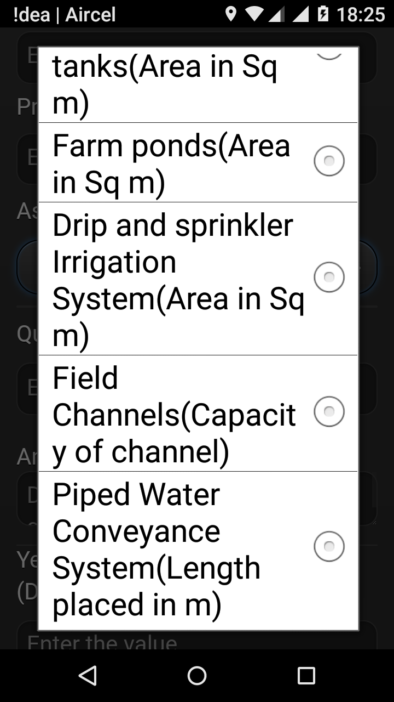
MINOR AND MICRO-IRRIGATION

Slide 33
NATURAL RESOURCE MANAGEMENT

Slide 37
SEEDS

Slide 46
THANK YOU
rkvy.nrsc@gmail.com
040-23884539
040-23884569
9989559169

